Slide 1

Introduction
Data Visualization

Slide 2
Course Points
50 Points Final Exam (MCQ & Essay)
30 Points Midterm Exam (MCQ Only)
10 Points Section
10 Points Practical Exam (Individually on Lab PC – Not project)

Slide 3
Goal
Datasets -> Questions -> Visualization -> Answers

Slide 4
Steps we must follow to achieve the goal
Step 1: Introduce the dataset.
Step 2: Collect all the questions set by the audience (stockholders, decision makers, top managers, ordinary people, or even children in pre-school) regarding the dataset.

Slide 5
Steps we must follow to achieve the goal
Step 3: Select the most accurate visualization chart by using the cognitive load principle. To help the audience to answer their questions in few seconds (NOTE: if the audience spent a lot of time to understand the chart and to get an answer for their question, then it means you choose the wrong chart).

Slide 6
Steps we must follow to achieve the goal
Step 4: Draw the chart using a pencil and a plain paper.
Step 5: Draw the chart using Python library (Plotly, Seaborn, Matplotlib).
Step 6: Evaluating the selected chart by using the concept of “story telling” and getting answers.

Slide 7
Important note
To achieve the goal of the course:
We are going to apply these 6 steps in each lecture until the end of the course

Slide 8
Before diviing into the 6 steps
At the beginning, we Must understand these concepts:
Drag/Drop-diven approach vs Code-driven approach. (Power BI & Tableau vs Python Libraries)
Visualizations Types: Exploratory vs Explanatory.
Cognitive Load.
Pre-attentive Attributes.

Slide 9
Drag/Drop-diven vs Code-driven
Drag/Drop diven approach:
Power BI and Tableau: These are "Business Intelligence" (BI) tools. They are designed for speed and accessibility, allowing users to create dashboards quickly using a drag-and-drop interface.

Slide 10
Drag/Drop-diven vs Code-driven
Code diven approach:
Python Libraries (Matplotlib, Seaborn, Plotly): These require writing code, which is more accurate for the Data Science students, visualization happens between data cleaning and machine learning. Using Python allows the student to keep the entire pipeline in one environment (like a Jupyter Notebook).

Slide 11
Drag/Drop-diven vs Code-driven
Feature | Power BI / Tableau | Python Libraries (Winner !!)
Primary User | Business Analysts / Managers | Data Scientists / Engineers
Method | Drag-and-Drop UI | Programming (Step 5 of our plan)
Scalability | Good for reporting and fast dashboards | Best for complex, custom AI/ML pipelines
Interactivity | High (Built-in) | High (when using Plotly)
Which Step | Step 5 | Step 5

Slide 12
Drag/Drop-diven vs Code-driven
And the winner is? for data science department
Power BI and Tableau are excellent for corporate reporting, but as Data Scientists, we use Python because it gives us the power to build custom, reproducible, and deeply integrated visualizations that are part of a larger analytical AI/ML engine. This reinforces why our course focuses on libraries like Matplotlib, Seaborn, and Plotly
Python Libraries (Such as Matplotlib, Seaborn, Plotly)

Slide 13
Drag/Drop-diven vs Code-driven
Feature | Matplotlib | Seaborn | Plotly (Winner !!)
Code Efficiency | Low (Requires more lines for styling). | High (Very concise). | Medium (Declarative).
Built-in Features | Basic; you must build everything manually. | High; handles themes and stats automatically. | High; includes legends, hover-data, and colors.
Speed of Coding | Slower due to "low-level" commands. | Fast for statistical plots. | Fast for complex layouts.
Interactivity | Static. No zoom or filter. | Static. No zoom or filter. | Fully Interactive. Zoom, pan, and hover.

Slide 14
Visualizations Types: Exploratory vs Explanatory
 | Exploratory | Explanatory
Definition | "Data Visualization for Me”. It is the stage where the Data Scientist explores the dataset to find patterns, outliers, or trends that aren't immediately obvious. | "Data Visualization for Them”. You have already found the insight, and now you are explaining it to the audience (managers, stockholders, etc.).
Goal | To understand what is happening in the data | To tell a story or answer a specific question in seconds.
Characteristics | Often messy, numerous, and lacks polish. You might create 50 charts in an hour to find one interesting insight. | Highly polished, clear titles, no "chart junk," and focuses only on the relevant data.
Which Step | Step 3 | Step 6

Slide 15
Cognitive Load
The total amount of mental effort being used in the audience's working memory to understand a chart.
In Step 3 of our course plan: choosing the most accurate chart so the audience can answer questions in just a few seconds. If the cognitive load is too high, the audience spends too much time trying to process the visual, which means you have chosen the wrong chart.

Slide 16
Cognitive Load
Load Type | High (Bad Case) | Low/Optimized (Good Case)
Extraneous | Using 10 different colors for 10 bars just for "fun." The brain works hard to find a meaning for each color. | Using one single color for all bars so the brain ignores color and focuses on length.
Intrinsic | Showing 100 brands on one Column Chart. The labels overlap and it's impossible to read. | Using a Bar Chart and showing only the "Top 10" brands to make the task manageable.
Germane | The manager is confused and asks, "What am I looking at?". | The manager immediately says, "I see Apple is leading; let's invest more there!".

Slide 17
Cognitive Load
The Three Types of Cognitive Load:
Type | Intrinsic Load | Extraneous Load | Germane Load
Definition | Effort required to understand the core information itself. | "bad" mental effort caused by poor design choices. It distracts the audience from the answer. | "good" mental effort. It is the energy the brain uses to learn the insight.
Example | Comparing the sales of 2 brands (Easy) vs. comparing the sales of 50 brands (Hard). For 50 brands, a Bar Chart manages the intrinsic load better than a Column Chart because it allows for easy scrolling and readable labels. | Using 3D effects on a Column Chart. The audience must mentally "flatten" the image to see where the top of the bar hits the gridline. | A manager looks at your Bar Chart and thinks, "Xiaomi is surprisingly close to Apple in Europe; we need to increase our marketing budget there.”. We want to minimize Extraneous load so that 100% of the audience's brainpower can go toward Germane load.

Slide 18
Cognitive Load
In the context of our Data Visualization course plan , our goal is to achieve the lowest cognitive load as much as possible, so the audience gets the answer in "few seconds".
We must reach the ideal balance:
Intrinsic Load (Low) + Extraneous Load (Dead) + Germane Load (High) = Low Cognitive load

Slide 19
Cognitive Load
Intrinsic Load (Manage it) - appropriate, not necessarily "low.” Some data is naturally complex; Your job is to choose a chart that makes this complexity manageable.
Extraneous Load (Kill it) - as low as possible. This is the "noise" that prevents the audience from seeing the "signal.", you should remove unnecessary 3D effects or distracting backgrounds.
Germane Load (Maximize it): as high as possible. High germane load means the audience is actually "learning"—their brain is working on the insight (e.g., "We are losing money in Europe!") rather than the chart mechanics (e.g., "What does this blue bar represent?").

Slide 20
Cognitive Load
We want to clear the 'trash' (Extraneous) and organize the 'work' (Intrinsic) so that the audience has 100% of their mental energy left for 'understanding' (Germane).”
If the audience spends too much time trying to understand the chart, you have likely forced them to waste their mental energy on Intrinsic and Extraneous Load.

Slide 21
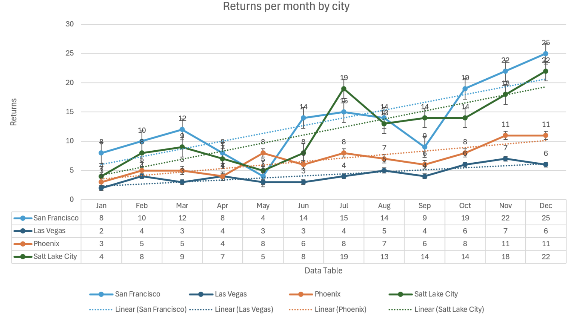
High Extraneous Load

Slide 22
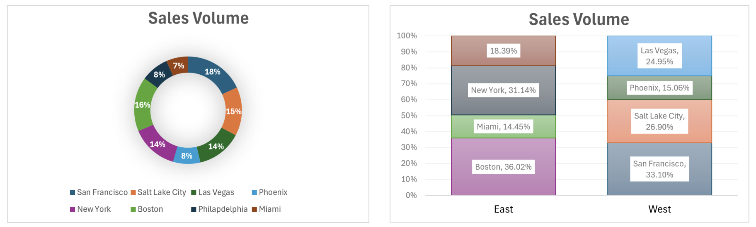
High (not properly organized) Intrinsic Load

Slide 23
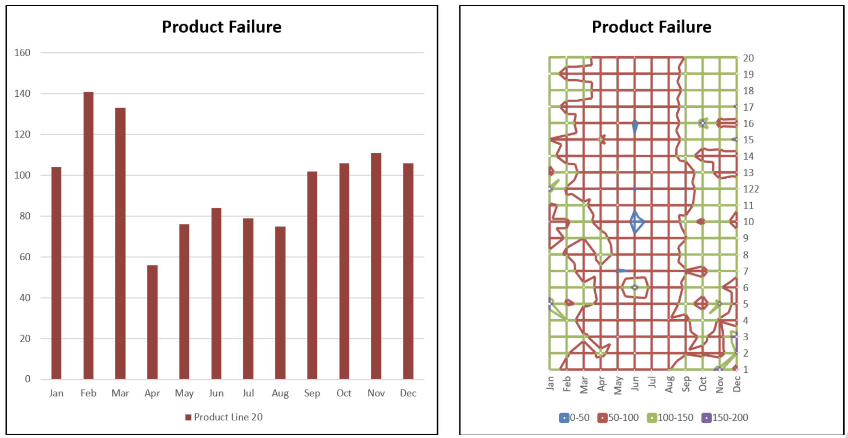
High (not properly organized) Intrinsic Load

Slide 24
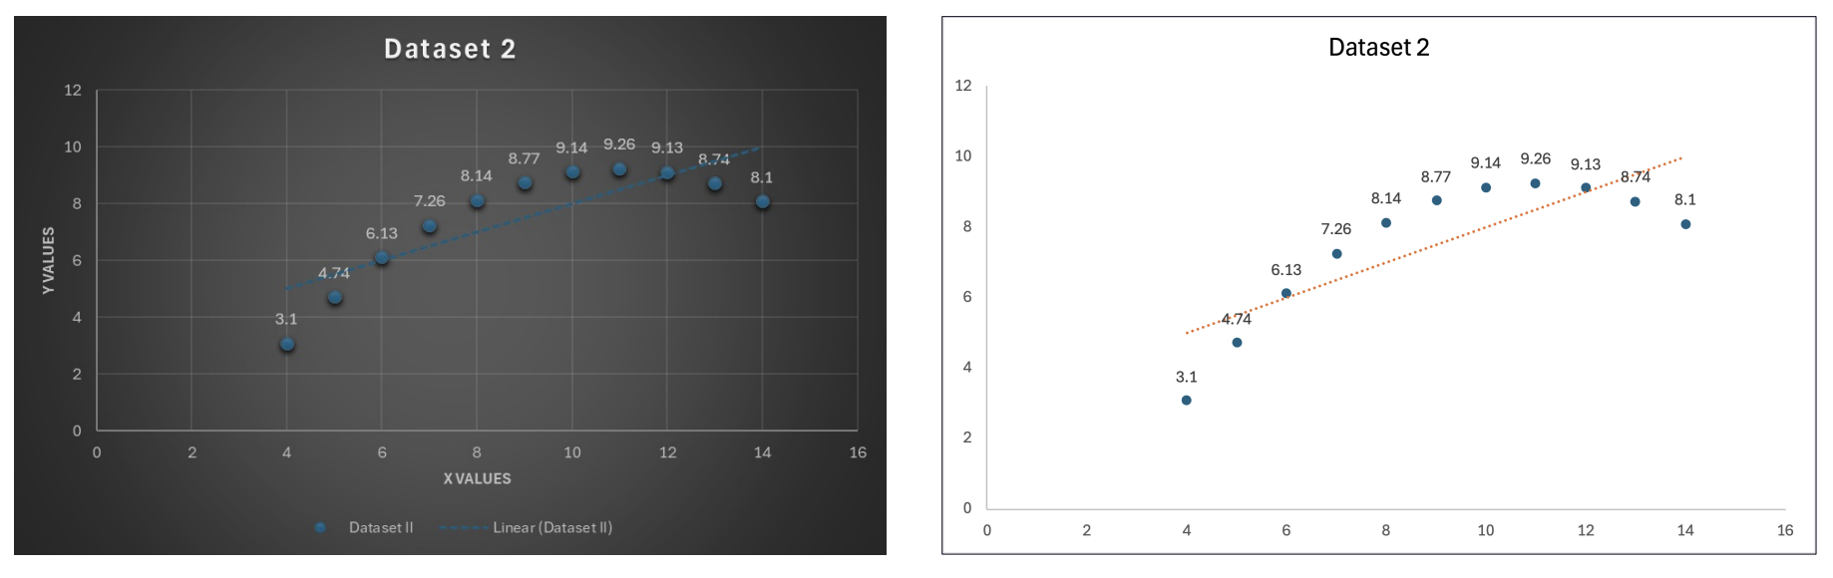
High Extraneous Load

Slide 25
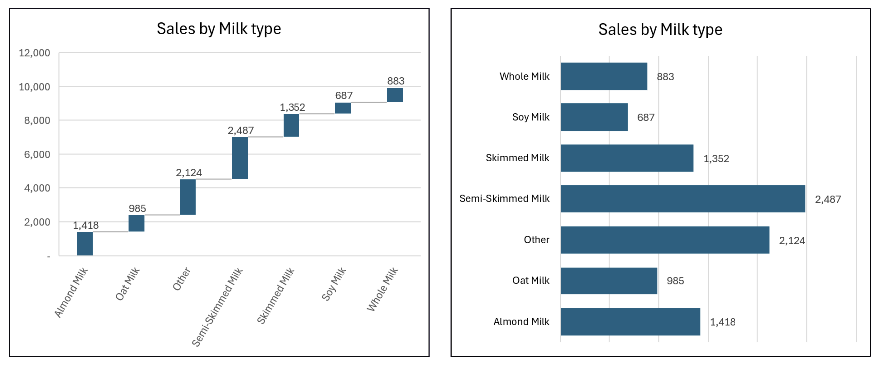
High (not properly organized) Intrinsic Load

Slide 26
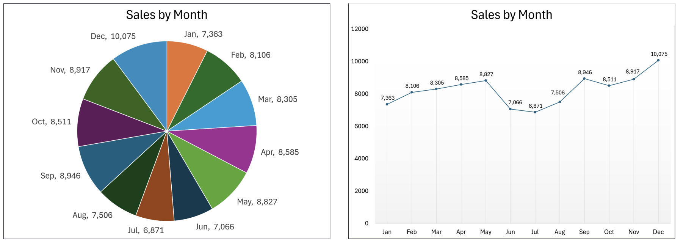
High (not properly organized) Intrinsic Load

Slide 27
Pre-attentive Attributes
Visual properties that the human brain processes automatically, without conscious effort
Guide viewer attention by making certain elements of a visualization stand out immediately, enabling fast recognition

Slide 28
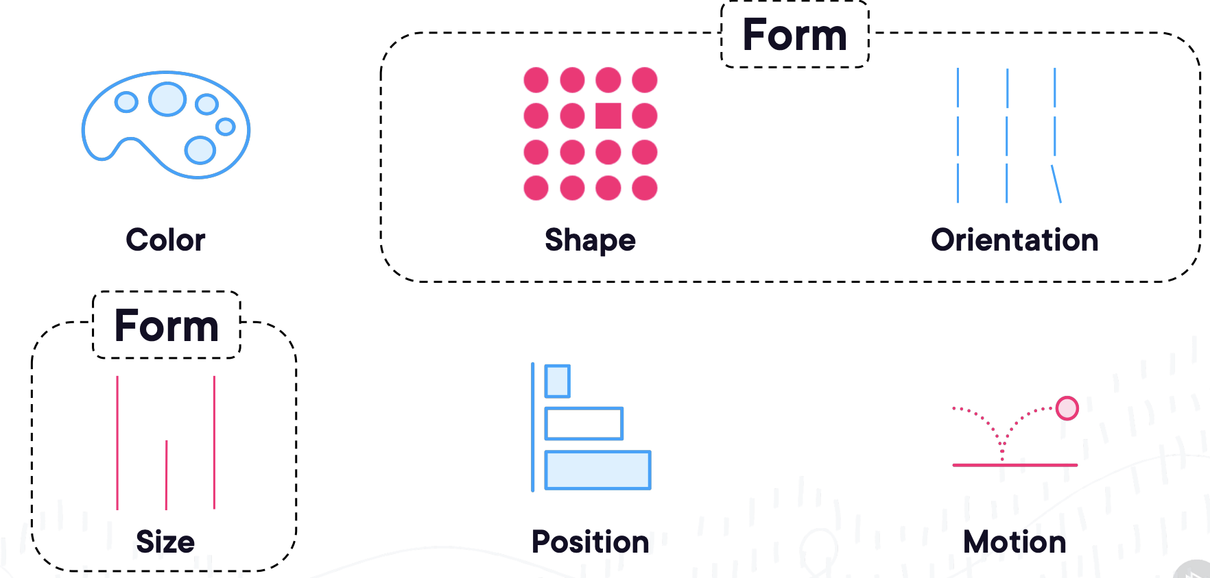
Pre-attentive Attributes

Slide 29
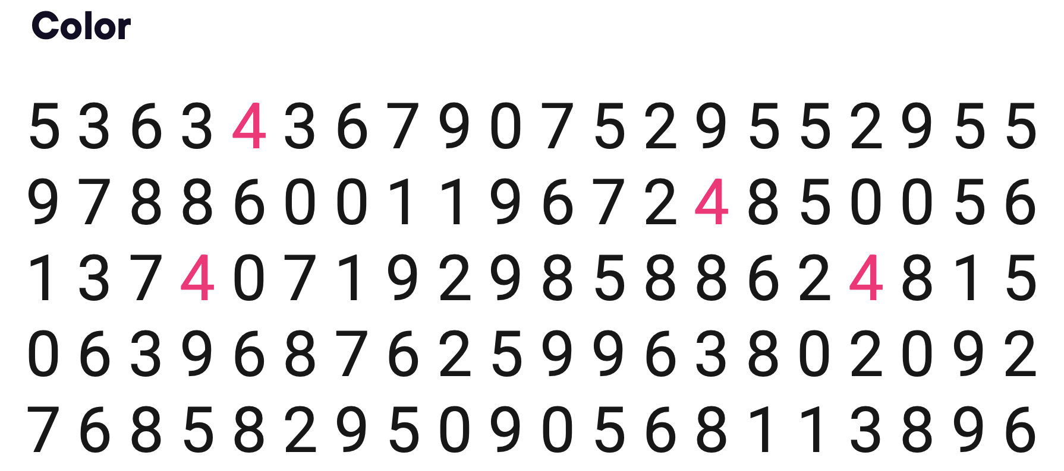
Pre-attentive Attributes

Slide 30
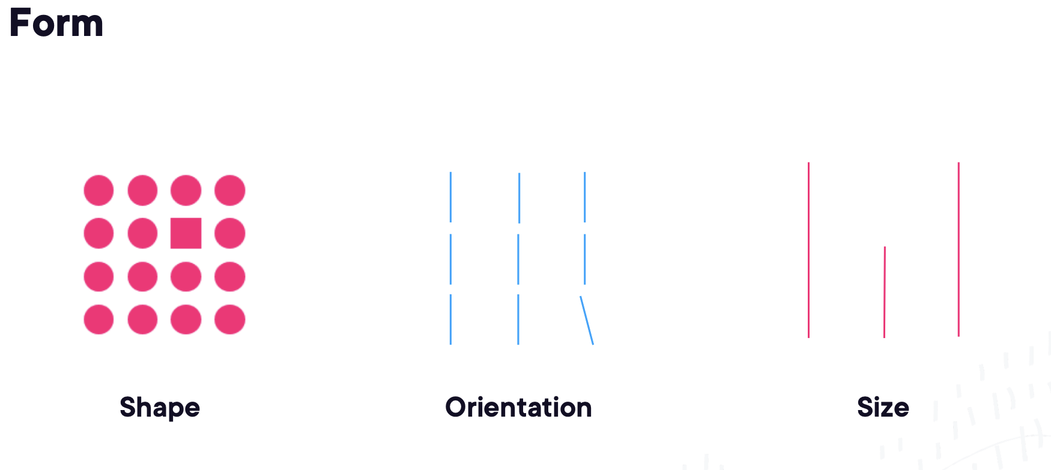
Pre-attentive Attributes

Slide 31
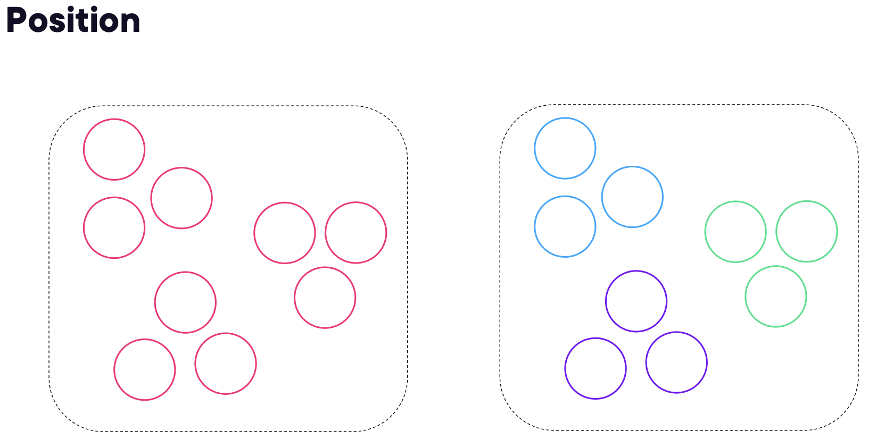
Pre-attentive Attributes

Slide 32
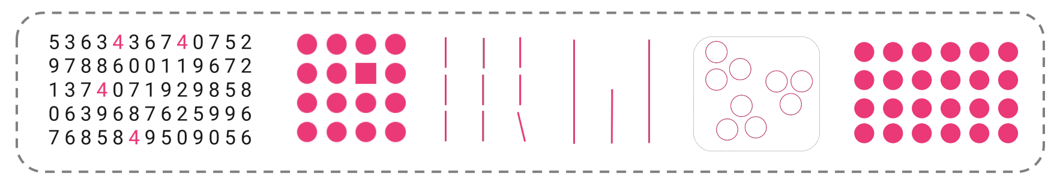
Pre-attentive Attributes

Slide 33
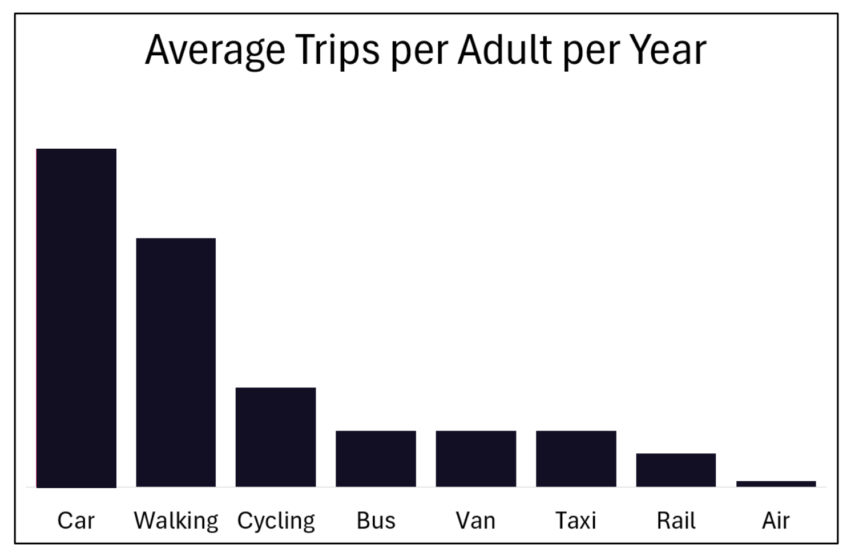
Pre-attentive Attributes

Slide 34
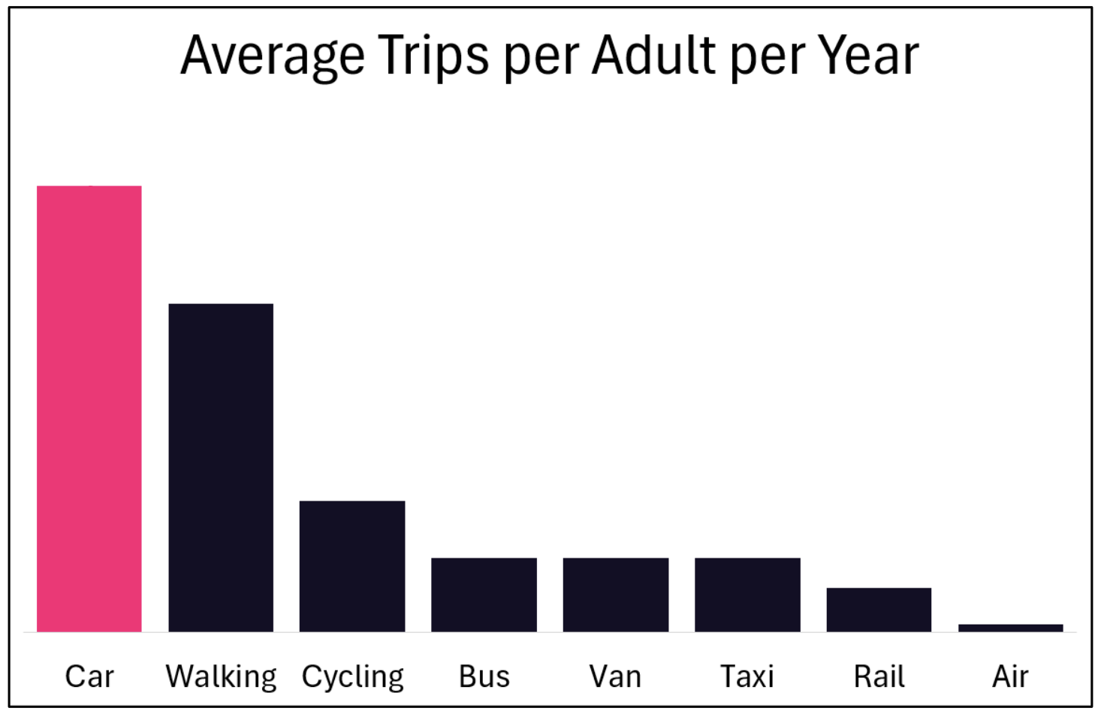
Pre-attentive Attributes
Use color to Guide viewer attention and to lower extraneous load

Slide 35
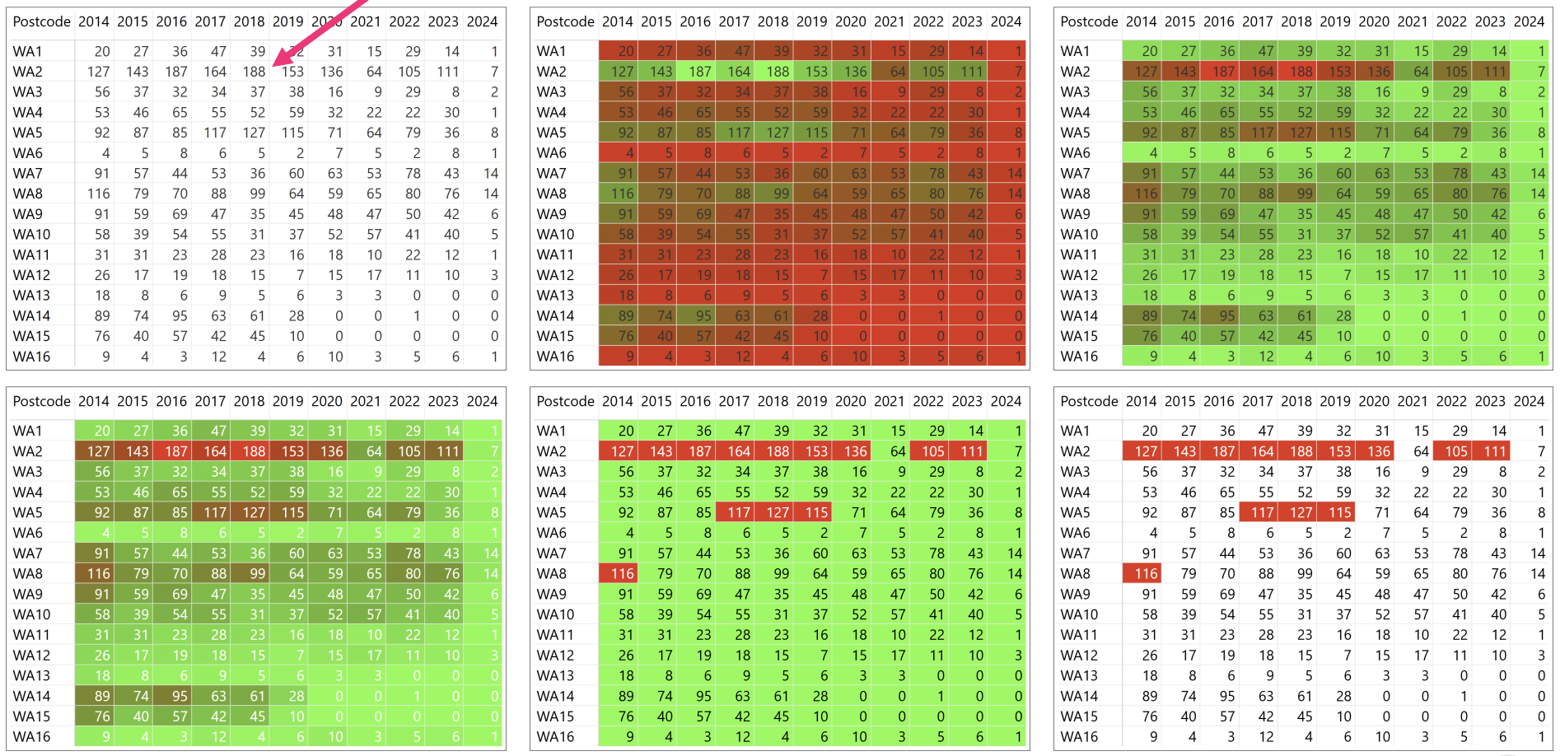
Use color to lower extraneous load

Slide 36
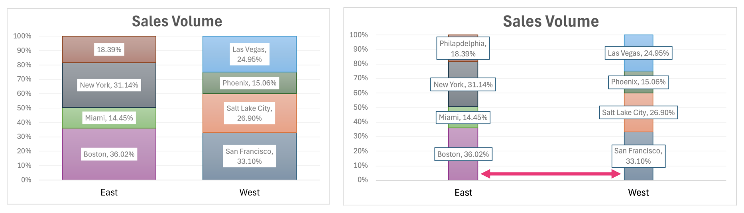
Use size to lower extraneous load

Slide 37
Pre-attentive Attributes
The result of mastering the use of pre-attentive attributes is:
Low Intrinsic Load Low Extraneous Load High Germane Load = Low Cognitive Load ;)

Slide 38
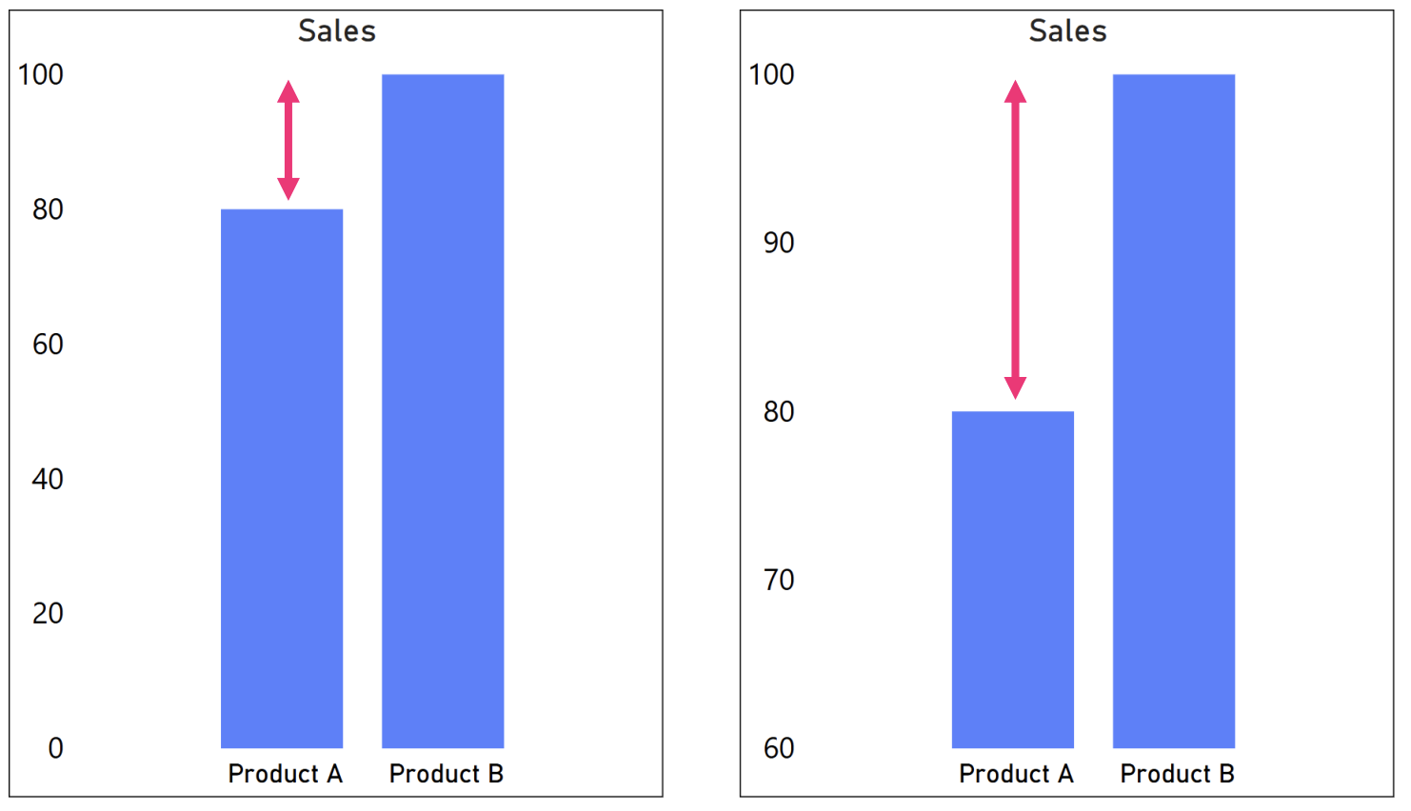
Common mistakes

Slide 39
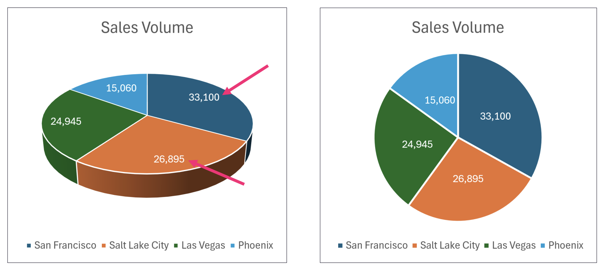
Common mistakes

Slide 40
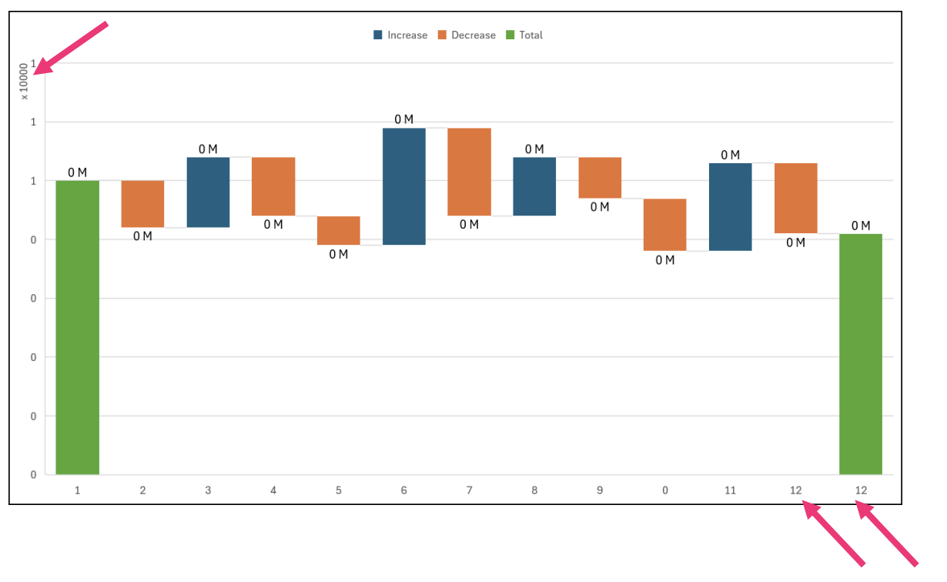
Common mistakes

Slide 41
